Slide 1
Structural Patterns
Composite
Decorator

Slide 2
Composite
Intent
Compose objects into tree structures to represent part-whole hierarchy.
Lets clients treat individual objects and composition objects uniformly
Applicability
Want to represent part-whole hierarchy
Want clients to be able to ignore the difference between composites and individuals
Notes:
Composite is the pattern to use when
you have collection of objects with whole-part relationships, and
you want to be able to treat those objects uniformly

Slide 3
Example 1: Company Structure
Organizational hierarchy btw Employees
Each worker has a manager
Each manager has a manager
Unless they are the Head of the company
Tree structure, let’s build a tree
Not enough…

Slide 4
Example 1: Company Structure
Organizational hierarchy btw Employees
Each worker has a manager
Each manager has a manager
Tree structure, let’s build a tree
Not enough…
I want to apply the same operations over both composite and individual objects
Say “move to 2nd floor” to a worker
Say “move to 2nd floor” to a manager, and their entire team moves to 2nd floor
Notes:
..and I want to define the roles worker + manager. Tree node acting like both needs a flag or attribute as marker.

Slide 5
Example 1: Company Structure
Tree structure
Node class which has children as other nodes
Client code should be able to request a leaf or a node uniformly
employee.print()
prints the subtree if the employee is a manager
prints the worker info if the employee is not a manager
employee.move()
employee.printVacationDays()
the primitive and composite objects are treated alike
Notes:
both the primitive and composite objects are treated alike

Slide 6
Composite - Structure
Participants?
Component
Client
+operation()
+add(Component)
+remove(Component)
+getChild(int)
*
children
Leaf
Composite
+operation()
+operation()
+add(Component)
+remove(Component)
+getChild(int)
for all g in children g.operation()
←This is a part of the pattern

Slide 7
Collaboration & Participants
Clients use the Component class interface to interact with objects in the composite structure.
If the recipient is a Leaf, then the request is handled directly.
If the recipient is a Composite, then it usually forwards requests to its child components, possibly performing additional operations before and/or after forwarding.

Slide 8
Composite Company
Employee
+move()
+print()
+add(Component)
+remove(Component)
+getChild(int)
Client
*
manages
Worker
Supervisor
+move()
+print()
+move()
+print()
+add(Component)
+remove(Component)
+getChild(int)
for(var e:children) e.move()

Slide 9
Composite company
Arbitrarily
complex tree
:Manager
:Manager
:Worker
:Manager
:Worker
:Worker
print()
:Manager
:Worker
:Worker
:Worker

Slide 10
Composite company
:Client
Client code:
employee.print()
:Manager
:Manager
:Worker
:Manager
:Worker
:Worker
print()
:Manager
:Worker
:Worker
:Worker
Prints the information of this worker

Slide 11
Composite company
:Client
Client code:
employee.print()
:Manager
print()
:Manager
:Worker
:Manager
:Worker
:Worker
:Manager
:Worker
:Worker
:Worker
Prints the information of the whole tree

Slide 12
Composite company
:Client
Client code:
employee.print()
:Manager
:Manager
print()
:Worker
:Manager
:Worker
:Worker
:Manager
:Worker
:Worker
Prints the subtree
:Worker
From Client perspective they are all the same

Slide 13
Sample code
abstract class Employee{
abstract void print();
void add(Component) {
//throw exception};
void remove(Component) {..};
Component get(int){….};
}
class Worker extends Employee{
private int data;
public void print(){
System.out.println(value);}
public Worker(int v){ data=v;}
}
class Manager extends Employee{
List<Employee> children;
void add (Employee c){
children.add(c);}
void remove(Employee c){
children.remove(c);}
Employee get(int i){
return children.get(i);}
void print(){
//…print own data first, then
for(Component c: children)
c.print();
}
public Manager(int v) {data=v;/*..*/};
private int data;
}

Slide 14
Sample client code
Employee example=new Manager(10);
example.add(new Worker(3));
example.add( new Manager(5).add(new Worker(2));
Employee another=new Manager();
…..
example.add(another);
….
example.print(); //print the whole structure
example.get(1).print(); //prints the whole subtree

Slide 15
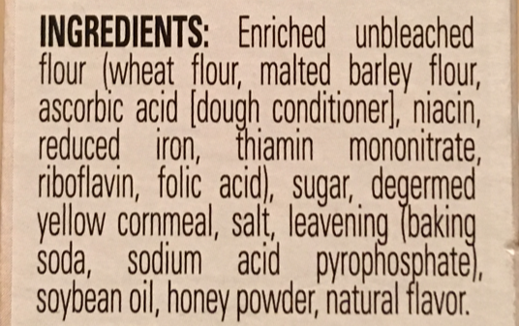
A recurring problem…
Any organizational hierarchy
Organizing files and folders
Is it different to move a file from move a folder?
Even printing ingredients☺
Graphical User
Interface frameworks
Swing, Qt, React
Notes:
moving a file versus moving a folder: The folder might contain other folders and files, so the operation has to cascade.
printing ingredients: some are simple, others are nested composites like 'enriched flour' with its own sub-ingredients.
modern GUI frameworks use the Composite: react, angular, java swing, javafx.qt
recurring problem: how do we apply operations uniformly across both individual items and groups of items?

Slide 16
Example 2: Scenario
A GUI system has window objects which can contain various GUI components (widgets) such as, buttons and text areas.
A window can also contain widget container objects which can hold other widgets.
We want to update the window and all its content for some user interactions
Problem:
How to represent these widgets?
Update one widget or whole window, e.g. change the theme

Slide 17
Example2: Solution 1
public class Window {
Button[] buttons;
Menu[] menus;
TextArea[] textAreas;
WidgetContainer[] containers;
public void update() {
if (buttons != null)
for (int k = 0; k < buttons.length;
k++) buttons[k].draw();
if (menus != null)
for (int k = 0; k < menus.length;
k++) menus[k].refresh();
// Other widgets handled similarly.
if (containers != null)
for (int k = 0; k<containers.length;
k++)containers[k].updateWidgets();
}
...
}
Solution 1: Design all the widgets with different interfaces for "updating" the screen.
a Window update() method
A bad solution
violates the Open-Closed Principle.
If we want to add a new kind of widget, we have to modify the update() method of Window to handle it.

Slide 18
Example2: Solution 2
Try to program to an interface. All widgets support the Widget interface,
subclasses of a Widget class
public class Window {
Widget[] widgets;
WidgetContainer[] containers;
public void update() {
if (widgets != null)
for (int k = 0; k < widgets.length; k++) widgets[k].update();
if (containers != null)
for (int k = 0; k < containers.length; k++ )
containers[k].updateWidgets();
}}
still distinguishing between widgets and widget containers
Notes:
either by being subclasses of a Widget class
or implementing a Java Widget interface.

Slide 19
The tree of widgets and containers
frame
button
panel
menu
menuitem
Textfield
panel
button
button

Slide 20
Applying the Composite
Widget
Window
+update()
+add(Component)
+remove(Component)
+getChild(int)
* components
widgetContainer
Button
Menu
+update()
+add(Component)
+remove(Component)
+getChild(int)
+update()
+update()
for all g in children g.update()

Slide 21
Example 2 –Composite pattern soln
abstract class Widget{
abstract void update();
void add(Component) {
//throw exception};
void remove(Component) {..};
Component get(int){….};
}
class Button extends Widget{
public void update(){
//updating this button
}
/*…other methods*/
}
class WidgetContainer extends Widget{
List<Widget> children;
void add (Widget c){
children.add(c);}
void remove(Widget c){
children.remove(c);}
Widget get(int i){
return children.get(i);}
void update(){
for(Widget c: children)
c.update();
}
/*…other operations and fields*/
}

Slide 22
Sample client code
public class Window{
private Widget root;
void initialize(){….}
/*….*/
public void update() {
root.update(); // updates itself and all its children
}
}

Slide 23
Example 3: Navigation menu
How a navigation menu looks (a sitemap)
Root —–Folder1 ————-File11 ————-File12 —–Folder2 ————-File21 ————-Folder21 ———————–File211 ————-Folder22 ————-Folder23 ———————–File231 —–Folder3
We only want to show those links to user which he is authorized to view.
if all the links in a category are not visible then the category itself will not be visible.
Operations: isAuthorized() and display()
Draw a class diagram…
http://www.zapbuild.com/bitsntricks/composite-design-pattern/

Slide 24
Component responsibilities
Its own responsibility
which are the leaf operations
e.g. employee methods
Child management
add(), remove(), getChild()
Trading single responsibility for uniform access

Slide 25
Implementation issues-1
Where should the child management methods (add(), remove(), getChild()) be declared?
In the Component class: Gives transparency, since all components can be treated the same. But it's not safe, since clients can try to do meaningless things to (add, remove) leaf components at run-time.
Add/remove fail by default, the composite overrides them
Add/remove does nothing, the composite overrides them
In the Composite class: Gives safety, since any attempt to perform a child operation on a leaf component will be caught at compile-time. But we lose transparency, since now leaf and composite components have different interfaces.

Slide 26
Implementation issues-1
In the Component class
Interpret the leaves as components with 0 child.
If we view a Leaf as a Component that never has children, then we can define a default operation for child access in the Component class that never returns any children.
Leaf classes can use the default implementation,
Throw exception by default
Do nothing by default
Return null or false
Composite classes will reimplement it to return their children, add or remove children
Interface segregation?
Notes:
Interface for accessing children is a fundamental part of a Composite class but not necessarily for Leaf classes.

Slide 27
Implementation issues-1
In the Composite class
Leaf and composite components have different interfaces
Requires the client to check the type of every object before making a call so the object can be cast correctly.
Uniformity is traded for safety
Notes:
Interface for accessing children is a fundamental part of a Composite class but not necessarily for Leaf classes.

Slide 28
Implementation issues-2
Should components maintain a reference to their parent component?
Depends on application
If needed, put the parent reference in the Component class
Add and Remove operations handle the parent reference
Suppose we have a reference to a child and need to delete it.
We must get the parent to remove the child.
Having the parent reference makes that easier.
Having parent references supports the Chain of Responsibility pattern (later)
Notes:
With parent references, it's essential to maintain the invariant that all children of a composite have as their parent the composite that in turn
has them as children. The easiest way to ensure this is to change a component's parent only when it's being added or removed from a composite.
If this can be implemented once in the Add and Remove operations of the Composite class, then it can be inherited by all the subclasses, and the
invariant will be maintained automatically.

Slide 29
Composite Pattern with Parent: C++
class Component{
public:
virtual ~Component() {}
virtual void add(Component *component) {}
virtual void remove(Component *component) {}
virtual Component *get(int i) const {return 0;}
virtual std::string operation() const = 0;
protected: Component *parent_;
void setParent(Component *parent) {
this->parent_ = parent; }
Component *getParent() const {
return this->parent_;
}
};
Problems?
class Leaf : public Component {
public:
string operation() const override {
return "Leaf"; }
};

Slide 30
Composite Pattern with Parent: C++
class Composite : public Component {
protected: std::list<Component *> children_;
public:
void add(Component *component) override {
this->children_.push_back(component);
component->setParent(this);}
void remove(Component *component) override {
children_.remove(component);
component->setParent(nullptr); } //assuming no sharing
std::string operation() const override {
std::string result;
for (const Component *c : children_) {
result += c->operation() + " "; }
return result;}
};

Slide 31
Composite Pattern with Parent: Java
public class Composite implements Component {
protected List<Component > children;
public void add(Component component) {
children.add(component);
component.setParent(this);}
public void remove(Component component) {
children.remove(component);
component->setParent(null); } //assuming no sharing
public string operation() {
StringBuffer result=new StringBuffer();
for (Component c : children) {
result.append( c->operation()).append (" “); }
return result.toString().trim();}
};

Slide 32
Implementation issues-3
Should Component maintain the list of components that will be used by a composite object?
Should children list be an instance variable of Component rather than Composite class?
Better to keep this part of Composite and avoid wasting the space in every Leaf object
Is child ordering important?
Depends on application:
parse tree, graphics front-to-back order

Slide 33
Implementation issues-4
Sharing components to remove redundancy
When components have reference to their parents, it gets tricky
Who should delete a component?
If there is garbage collection, like Java, this is not an issue
Composite deletes its children when destroyed
Destructor of Composite calls destruct for all children
Careful when components are shared by multiple composites
Notes:
Sometimes, if the composite structure is complex or expensive to traverse, it’s helpful to implement caching of the composite nodes. For instance, if you are constantly traversing a composite and all its children to compute some result, you could implement a cache that stores the result temporarily to save traversals.

Slide 34
Composite –Known uses
GUI frameworks
Web page layouts
Look at java.awt package
* children
Component
Label
Button
TextField
Container
Panel
Frame
Notes:
File systems
GUser Interface frameworks
Document editors
Web page layout
Billing and invoicing
Organizational structures

Slide 35
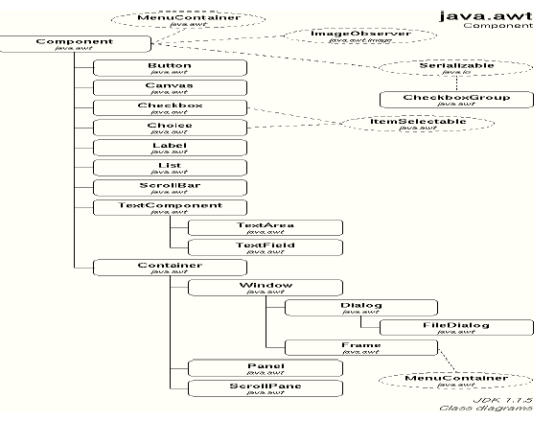

Slide 36
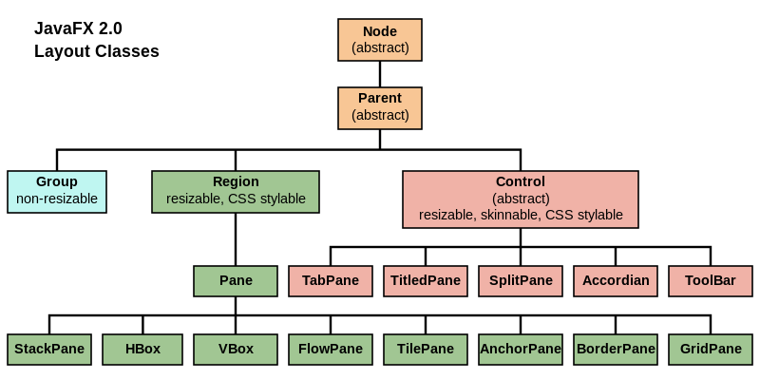

Slide 37
Composite - Consequences
Defines class hierarchies consisting of primitive and composite objects
Clients can treat composite structures and individual objects uniformly
Simpler clients, no case-based handling
Client can make one method call and execute an operation over an entire structure.
Easier to add new kinds of components
Makes it harder to restrict the components of a composite.You have to check the constraints on runtime
Notes:
Client code does not have if statements to make sure they’re calling the right methods on the right objects.

Slide 38
Decorator

Slide 39
Motivation
Sometimes we want to add responsibilities to individual objects, not to an entire class
E.g. I want to add scrollbar to a TextArea
We can do this with inheritance, but it limits our flexibility.
How to add and withdraw scrollbar whenever necessary?
Change the type of the object at runtime?
Later, I want to add border to some TextArea objects
Too many subclasses!
A better way is to use object composition!

Slide 40
Question
What if I put flags for each add-on
isScroolbar, isBorder,…..
Loosing advantage of object orientation
Violates which principle?
No more class explosion
I can withdraw scrollbar by setting the flag to false
Not a good idea

Slide 41
Object composition
TextArea and Border. Who composes whom?
TextArea contains Border
Must modify subclasses, if any, to make it aware of the border.
Border contains TextArea
keeps the border-drawing code entirely in the Border class, leaving other classes alone.
What does the Border class look like?
Clients should not care whether TextArea objects have borders or not.
Border and TextArea have the same interface
Border is decorating the TextArea
Notes:
GoF“They should treat glyphs uniformly. When clients tell a plain, unbordered glyph to draw itself, it should do so without embellishment. If that glyph is composed in a border, clients shouldn't have to treat the border containing the glyph any differently; they just tell it to draw itself as they told the plain glyph before. This implies that the Border interface matches the Glyph interface. We subclass Border from Glyph to guarantee this relationship.”
Glyph->textarea

Slide 42
Decorator
Intent
Attach additional responsibilities to an object dynamically
a.k.a. Wrapper
You’ll be able to give objects new responsibilities without changing the client code
Notes:
Instead of inheritance, add decorate your objects at runtime: A form of object composition
Adding decoration could be responsibility of another class.
User of the object does not differentiate whether it is talking to a real object or a decorated one

Slide 43

Decorator is a Wrapper
Think of decorator objects as “wrappers.”
Component
Wrapping additional responsibility
Decorated Component
Wrapping with composition

Slide 44
Decorator -Structure
Participants?
Component
inner
+operation()
ConcreteComponent
Decorator
+operation()
+operation()
component.operation()
{inner.operation();
addedBehavior();}
ConcreteDecoratorA
ConcreteDecoratorB
addedState
+operation()
+operation()
+addedBehavior()
Notes:
Aggregation=Decorator has a field of type component it wraps
AddedState=decorator can extent the state of the component
addedBehavior=decorator can add new method; however, new behavior is typically added by doing computation before/after an existing method in the component
Inheritance=for type matching not for adding new behavior
CDA.operation=delegate to component.operation() and do more computation

Slide 45
Key points
Decorator forwards requests to its Component object.
A concrete decorator executes its behavior before or after the call to the parent method
which always delegates to the wrapped object
operation()
operation()
Component
Decorator is a Wrapper
originalValue
Decorated Component
value

Slide 46
Key points
Decorator forwards requests to its Component object.
A concrete decorator executes its behavior before or after the call to the parent method
which always delegates to the wrapped object
We can pass around a decorated object in place of the original (wrapped) object.
Decorators have the same supertype as the objects they decorate.
Objects can be decorated at any time
We can decorate objects dynamically at runtime with as many decorators as we like

Slide 47
Key points
We can use one or more decorators to wrap an object.
Chaining decorators is like layering logic
We can structure the business logic into layers,
create a decorator for each layer and compose objects with various combinations of this logic at runtime.
The client code can treat all these objects in the same way, since they all follow a common interface.

Slide 48
Decorator
Intent
Attach additional responsibilities to an object dynamically.
Applicability
Need to add responsibility to individual objects dynamically and without affecting others
Need to add responsibilities that can be withdrawn
Allow behavior to extend without modifying or breaking the code that uses these objects.
When extension by subclassing is impractical
Class definition may be hidden
Large number of independent extension will result subclass explosion
Notes:
The Decorator lets you structure your business logic into layers, create a decorator for each layer and compose objects with various combinations of this logic at runtime. The client code can treat all these objects in the same way, since they all follow a common interface.

Slide 49
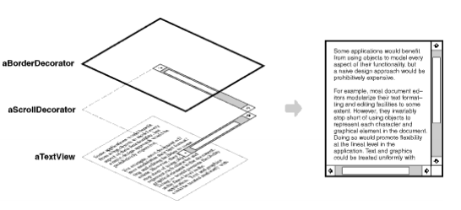
Example 2: Decorating with borders and scrollbars
Scrollbar will be added whenever necessary
Draw a class diagram

Slide 50
class Widget{
public: virtual void draw() = 0;
};
class TextView: public Widget{
int width, height;
public:
TextView(int w, int h)
:width(w),height(h){}
virtual void draw(){/*actual draw*/ }
};
class Decorator: public Widget {
Widget *wid;
public:
Decorator(Widget *w): wid(w){}
virtual void draw(){
wid->draw(); // Delegation
}
};
class BorderDecorator: public Decorator{
public:
BorderDecorator(Widget *w): Decorator(w){}
void draw(){
Decorator::draw();
cout << “after--BorderDecorator" << '\n';
}
};
class ScrollDecorator: public Decorator{
public:
ScrollDecorator(Widget *w): Decorator(w){}
void draw(){
cout << " before-- ScrollDecorator" << '\n';
Decorator::draw();
}
};
Write a client that builds a double bordered textview with a scrollbar.
Notes:
int main(){
Client has the responsibility to compose desired configurations
Widget *aWidget = new BorderDecorator(new BorderDecorator(new ScrollDecorator
(new TextView(80, 24))));
aWidget->draw();
}

Slide 51
Example 3:
We have a FileReader implementing a Reader interface
but sometimes we want to read the number of lines in a file
Decorate FileReader with LineNumberReader
IReader
FileReader
Decorator
+readLine()
+readLine()
LineNumberReader
+readLine()
+getLineNumber()
Notes:
Multiple decorator
Reader r=new ParagraphD(new LineNumberD(new FileREader()));
r.readline() will call Paragraph.readline. Do something there and then call LineNumberDecorator.
Do another thing there and then call filereader.readline

Slide 52
Example 3: LineNumberReader
abstract class Decorator implements Reader{
private Reader innerObject;
public Decorator(Reader r){innerObject=r;}
public String readline(){ innerObject.readLine();}
}
class LineNumberReader extends Decorator{
int counter;
public LineNumberReader(Reader inner){ super(inner);}
public String readline(){ super.readLine(); counter++;}
public int getLineNumber(){return ccounter;}
}
Client code
FileReader fr=new FileReader(filename);
LineNumberReader lrdr = new LineNumberReader(fr);

Slide 53
Decorator object diagram
Toast t1=new Toast(); t1.getPrice() //5
Toast t2= new ExtraCheese( new Toast() ); t2.getPrice()//8
Toast t3 = new Meat(new Toast()); t3.getPrice()//9
Toast t4= new Meat( new ExtraCheese( (new Toast()))); t4.getPrice()// 12
Toast t5 =new ExtraCheese(new Meat((new ExtraCheese(new Toast()))));
t5.getPrice(); //15
----
Toast::getPrice() { return 5;}
ExtraCheese::getPrice(){ return inner.getPrice() + 3}
Meat:: getPrice(){ return inner.getPrice()+4}

Slide 54
t5:ExtraCheese
:Meat
:ExtraCheese
:Toast
getPrice
getPrice
getPrice
getPrice
5
8
15
12

Slide 55
Implementation issues
Keep Component lightweight
Java interface, C++ pure virtual
concrete class should not pay for features they do not need
Intrinsically heavyweight Component makes the Decorator pattern too costly to apply.
Adding only one responsibility, abstract decorator may be overkill
Forwarding the request is in the concrete one
Decoration order do matter
Notes:
1) Putting a lot of functionality into Component also increases the probability that concrete subclasses will pay for features they don't need. ?? Interface segregation
Component class is intrinsically heavyweight, thereby making the Decorator pattern too costly to apply. → think strategy
2)Usually there is an existing hierarchy

Slide 56
Known Uses
X Window use Decorators to add a title bar, border, and scroll bars to a window
The java.io package
FileInputStream is wrapped with BufferedInputStream
Further wrapped with LineNumberInputStream
Both wrappers extend FilterInputStream (abstract decorator)

Slide 57
Know use
java.io.InputStream structure
InputStream
FileInputStream
FilterInputStream
DataStream
BufferedInputStream

Slide 58
Known use: java.io package
The basic I/O classes are InputStream, OutputStream, Reader and Writer
Decorations:
Buffered Stream - adds buffering for the stream
Data Stream - allows I/O of primitive Java data types
Pushback Stream - allows undo operation
Notes:
All subclasses of java.io.InputStream, OutputStream, Reader and Writer have a constructor taking an instance of same type.

Slide 59
Example decoration chaining
public class JavaIO {
public static void main(String[] args) {
// Open an InputStream.
FileInputStream in = new FileInputStream("test.dat");
// Create a buffered InputStream.
BufferedInputStream bin = new BufferedInputStream(in);
// Create a buffered, data InputStream.
DataInputStream dbin = new DataInputStream(bin);
// Create an unbuffered, data InputStream.
DataInputStream din = new DataInputStream(in);
// Create a buffered, pushback, data InputStream.
PushbackInputStream pbdbin = new PushbackInputStream(dbin);
}
}
Notes:
I can do it in 1 line as well
PushbackInputStream pbdbin = new PushbackInputStream(new DataInputStream(new BufferedInputStream(new FileInputStream("test.dat")))));

Slide 60
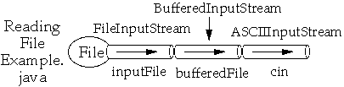
class ReadingFileExample {
public static void main( String args[] ) throws Exception {
ASCIIInputStream cin =new ASCIIInputStream(
new BufferedInputStream (
new FileInputStream( "ReadingFileExample.java" );
System.out.println( cin.readWord() );
for ( int k = 1 ; k< 4;k++ ) System.out.println( cin.readLine() );
}
}

Slide 61
Decorator – Consequences: Pro
Flexible alternative to inheritance for extending functionality
Adding/removing responsibility at runtime
Mix and match responsibilities
Decorators are simple and stackable
Avoid class explosion due to inheritance
Big Pro
Notes:
Pro:
More flexibility than static inheritance --- BIF PRO
Single responsibility = decorator.
2. Avoids feature-laden classes high up in the hierarchy. Decorator offers a pay-as-you-go approach to adding responsibilities. Instead of trying to support all foreseeable features in a complex, customizable class, you can define a simple class and add functionality incrementally with Decorator objects. Functionality can be composed from simple pieces. As a result, an application needn't pay for features it doesn't use. It's also easy to define new kinds of Decorators independently from the classes of objects they extend, even for unforeseen extensions. Extending a complex class tends to expose details unrelated to the responsibilities you're adding.

Slide 62
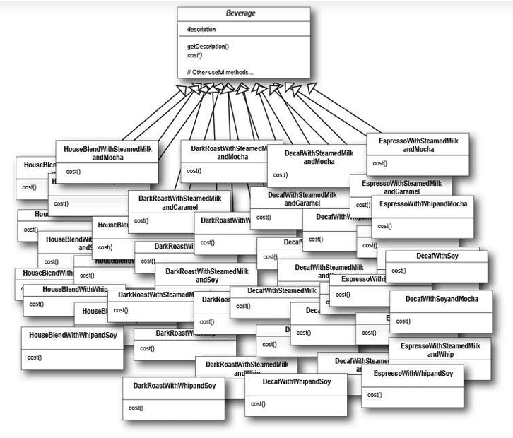
Source: Head First Design Patterns. Reading this chapter is advised

Slide 63
Decorator – Consequences: Pro
Flexible alternative to inheritance for extending functionality
Adding/removing responsibility at runtime
Mix and match responsibilities
Decorators are simple and stackable
Avoids complex classes high up in the hierarchy
Keep base simple, Add functionality incrementally
a client need not pay for features it does not use.
Easy to extend, no need to crowd the base
Extending a complex class tends to expose details unrelated to the responsibilities being adding.
Enables Single Responsibility
divide a monolithic implementing many possible variants of behavior into several smaller ones.
Notes:
Pro:
More flexibility than static inheritance --- BIF PRO
Single responsibility = decorator.
2. Avoids feature-laden classes high up in the hierarchy. Decorator offers a pay-as-you-go approach to adding responsibilities. Instead of trying to support all foreseeable features in a complex, customizable class, you can define a simple class and add functionality incrementally with Decorator objects. Functionality can be composed from simple pieces. As a result, an application needn't pay for features it doesn't use. It's also easy to define new kinds of Decorators independently from the classes of objects they extend, even for unforeseen extensions. Extending a complex class tends to expose details unrelated to the responsibilities you're adding.

Slide 64
Decorator – Consequences: Cons
Do not rely on identity check
They have the same interface, but decorated object is not identical to the object itself.
Lots of little objects that all look alike
Differ only the way they are connected
Hard to understand the design and hard to debug
Be cautious!
Initial configuration is ugly ☺
See Java I/O
Notes:
Pro:
1. More flexibility than static inheritance
2. Avoids feature-laden classes high up in the hierarchy. Decorator offers a pay-as-you-go approach to adding responsibilities. Instead of trying to support all foreseeable features in a complex, customizable class, you can define a simple class and add functionality incrementally with Decorator objects. Functionality can be composed from simple pieces. As a result, an application needn't pay for features it doesn't use. It's also easy to define new kinds of Decorators independently from the classes of objects they extend, even for unforeseen extensions. Extending a complex class tends to expose details unrelated to the responsibilities you're adding.
Cons:
Do not rely on object identity when you use decorators.
Lots of objects: The objects differ only in the way they are interconnected, not in their class or in the value of their variables. Although these systems are easy to customize by those who understand them, they can be hard to learn and debug.
Implementation

Slide 65
Decorator-Related Patterns
Adapter modifies an objects interface.
Decorator only alters an objects behaviors while maintaining the interface.
Composite: Decorator looks like a degenerate composite, but the intention is different
Object aggregation vs adding responsibilit
Proxy: wrapping objects for different Intent
Strategy : Change the skin vs change its guts
(later)
Notes:
Proxy usually manages the life cycle of its service object on its own, whereas the composition of Decorators is always controlled by the client.

